Slide 1
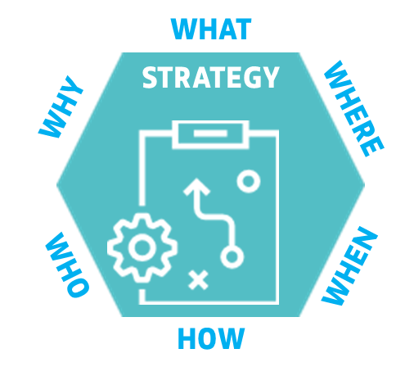
Topic title: Creating attacking opportunities from last third throw in part 1
^{Who:}
^{Primary Players:}
^{Individual – No# 3}
Primary Unit – No’s. #6, #3, #8, #10
^{Secondary Unit – No’s. #9, #11}
^{What:}
Focus on keeping possession from the throw and seeing where and how we can attack from this position.
^{When:}
Attacking through throw ins, in possession and when we are at a numerical advantage in final third.
^{Where:}
^{Pitch Zones 1,2,3,4,5,6,7,8,9}
^{How:}
Attack v defence with multiple outcomes working predominantly with securing the ball from a throw and creating attacking opportunities
Why:
I want my players and team to be better at keeping the ball from throw ins and learning attacking pictures and opportunities.
Principles of play ( In Possession)
^{Creativity}
^{Support}
^{Movement}
^{Create space}
^{Penetration}
Key Factors:
Reaction/set up from throw
Receiving ball from throw
Throw in technique
Keeping possession
Creating overloads
Creating chances
Intended Learning Outcome: I want my players to keep possession from the throw and understand where and when we create outnumbered pictures.
Notes:
Please insert session title, your name and your organisation/club

Slide 2
Principles of play
In Possession
USE IT
DEFEND THE
COUNTER ATTACK
LOSE IT
Creativity
Press
Transition
6 seconds
Support
Delay
Movement
Cover and Balance
Create Space
Compactness
Transition
6 seconds
Penetration
Control and Restraint
WIN IT
EXPLOIT THE
COUNTER ATTACK
Out of Possession
DEFEND IT

Slide 3
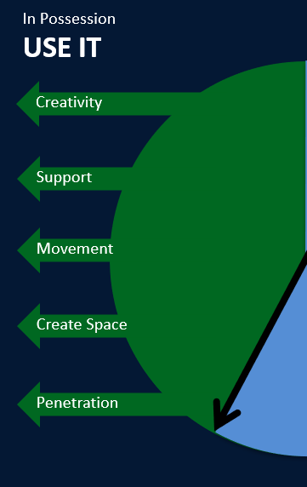



In Possession
Key
Attacker/team 1
Defender/team 2
Team 3
Team 4
Goalkeeper 1
Goalkeeper 2
Server
Ball
Goal
Mini goal
Cone
Mannequin
Player movement
Ball movement
Zoned area
Zone line
Highlighted Zone
Picture

Slide 4
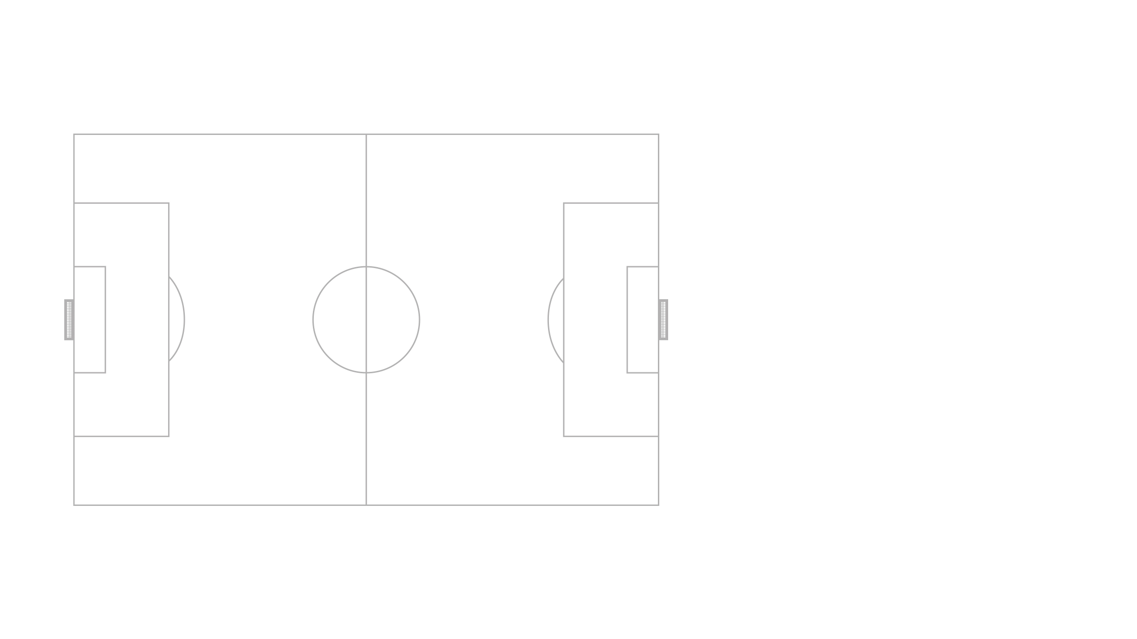
Topic: Always plan back from the 11 v 11 or 9 v 9 game
Coach a team to improve their ability to attack from a throw in inside the final third.
Creating and scoring
Blue Team
GK – 3 – 5 - 2
Green Team
GK – 4 -3 – 3
Progressing and penetrating
Counter attacking
Retaining and Building
Notes:
This pitch has been locked and can not be moved or resized

Slide 5
Topic: 6 v 6 Practice
Coach a team to improve their ability to attack from a throw in inside the final third.
Creating and scoring
Blue Team
4 – 2
Green Team
GK – 4 -1
Picture 3
Progressing and penetrating
Counter attacking
Retaining and building
Picture 2
Picture 1
Notes:
This pitch has been locked and can not be moved or resized

Slide 6
Coach a team to improve their ability to attack from a throw in inside the final third.
Organisation
6 v 6
4 – 2 v GK – 4 - 1
57 yds x 50 yds area
3 goals, 2 (7v7) defending team to attack one full size for attacking team.
Balls side off pitch at re-start throw-ins
Offsides to be played
Management
Directional practice against the interference of the other team
Progression:
Free flowing game, add time limit if needed.
Players utilize normal throw-ins, no corners, restarts from throw-ins
50 yards
Picture 3
Communication:
Provide a walk throughs
Use Guided discovery to support the players
Pose questions during tactical discussion
Use of show and tell examples (Provide alternatives ie ‘Best Option)
Observations (How and what to look for)
Initially observe behind the # Then behind the #6.#8
Look for movement and how individuals apply technical / tactical outcomes and then observe collective returns
Key factors:
- (Reaction) movement in possession
Individually: retaining and building play, creating space.
Starting shape as a team
Creativity
Support – angle, distance, speed of movement
Create space
Penetration
57 yards
3 v 2 initially
Picture 2
Notes:
The size and orientation of this pitch can be changed

Slide 7

Organisation
6 v 6
4 – 2 v GK – 4 - 1
57 yds x 50 yds area
3 goals, 2 (7v7) defending team to attack one full size for attacking team.
Balls side off pitch at re-start throw-ins
Offsides to be played
Topic:
Coach a team to improve their ability to defend when outnumbered (Practice)
Management
Directional practice against the interference of the other team
Progression:
Free flowing game, add time limit if needed.
Players utilize normal throw-ins, no corners, restarts from throw-ins
50 yards
Communication:
Provide a walk throughs
Use Guided discovery to support the players
Pose questions during tactical discussion
Use of show and tell examples (Provide alternatives ie ‘Best Option)
Observations (How and what to look for)
Initially observe behind the # # Then behind the #9,#11
Look for movement and how individuals apply technical / tactical outcomes and then observe collective returns
Key factors:
- (Reaction) movement in possession
Individually: retaining and building play, creating space.
Starting shape as a team
Creativity
Support – angle, distance, speed of movement
Create space
Penetration
57 yards
Notes:
The size and orientation of this pitch can be changed

Slide 8
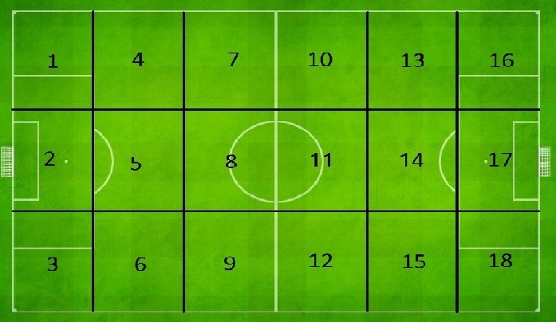

Slide 9
Title:Coach a team to improve their ability to attack from a throw in inside the final third.
Session Information
Organisation – Conditioned Practice – GK+5v6 (6v6)
Game constraints –Playing in possession from throw in inside final third.– no constraints in possession – off-side applies in attacking final third
Free play – score, win ball back if lose possession.
Technical information
Start position(Reaction) winning ball from throw
Throw in– initial reaction – who to throw to, speed of movement, body shape in relation to throw in-team mates
2nd picture create 3v2, decision making (take time see, understand, deliver)
3rd picture, attack goal and create 1v1 where possible. (quickest way)
Body shape and type off pass for surface, situation

Slide 10
Title:Coach a team to improve their ability to attack from a throw in inside the final third.
Tactical considerations:
Anticipate a transition/turnover
Create opportunities in behind the defence, create space (maintain, exploit)
Create overloads 3v2 (picture 2)
Decision making of individual, movement and creativity.
Attacking players – speed, direction, player or space. (body position to receive)
Force play towards the goal.
Goal keepers positioning, Looking to see if to high or to one side.
Timing off movement (create, maintain, exploit space) and support with speed.
React quickly and attack once in possession (Don’t forget security behind the ball)

Slide 11
Review of the session:
FA underpinning philosophy
Approach to practice design
Practice methodology (Plan, Do, Review)
Type of practice demonstrated
Did I get my outcomes?
“ At the end of the session, I want my players to be better at?”.......
……………………….What?

Slide 12


ANY QUESTIONS?

